Slide 1

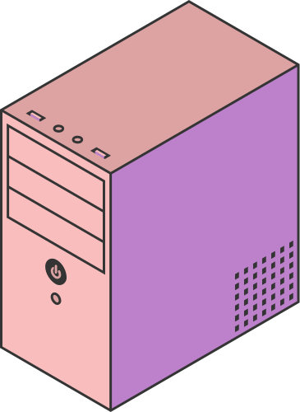
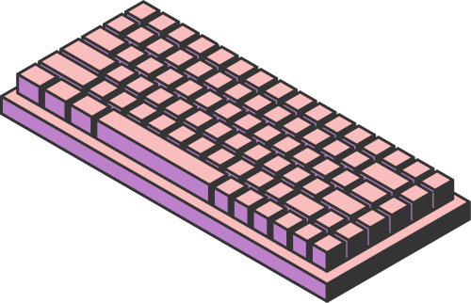
Implementing VPN Solutions with FortiGate
Page 01

Slide 2



GOAL OF THE PROJECT
To design and simulate a secure Enterprise VPN architecture using GNS3 and FortiGate, covering:
  Basic LAN/WAN setup
  IPsec site-to-site VPN (HQ ↔ Branch)
  SSL-VPN remote access
  SD-WAN for intelligent WAN routing and failover
Page 02

Slide 3

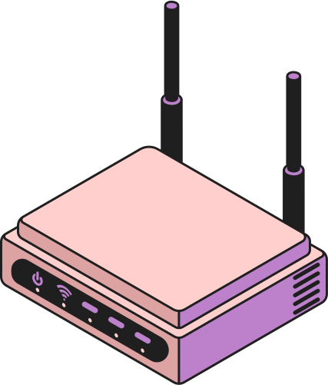

LAB TOPOLOGY
Components:
  2 FortiGates (HQ & Branch)
  2 “ISP clouds” simulating WAN networks
  HQ LAN + Branch LAN PCs
  Management network (VMnet1) for GUI access
  WAN networks (VMnet2 & VMnet3)
  GNS3 VM to emulate FortiGate KVM appliances
Management IPs:
  HQ GUI: Management IPs:
  HQ GUI:
  Your PC: 172.16.1.1 (VMnet1)
  Branch GUI: Management IPs:
  HQ GUI:
  Your PC: 172.16.1.1 (VMnet1)
Your PC: 172.16.1.1 (VMnet1)
Page 03

Slide 4
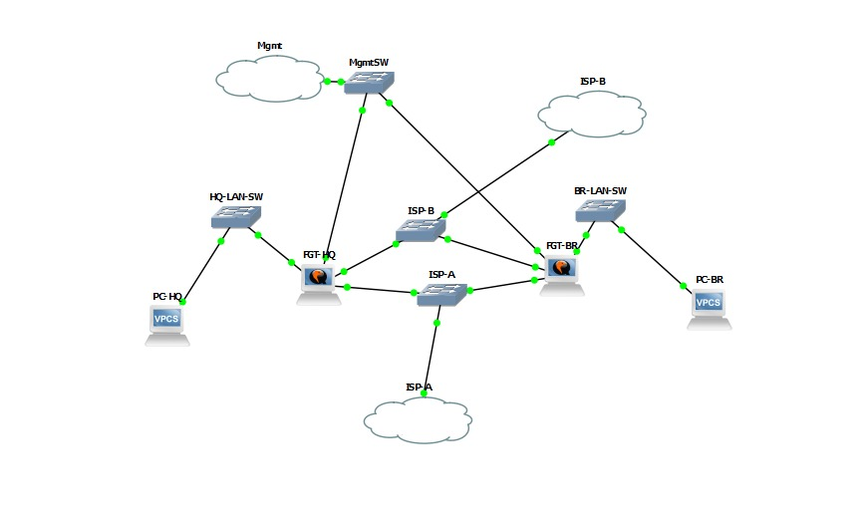

Slide 5

WHAT WE SUCCESSFULLY BUILT
1. LAN Configuration
  HQ LAN: 10.0.1.0/24
  Branch LAN: 10.0.2.0/24
  PCs assigned:
    HQ PC: 10.0.1.10 / gateway 10.0.1.1
    Branch PC: 10.0.2.10 / gateway 10.0.2.1
2. WAN Simulation
Using VMware VMnet networks:
  WAN1 (ISP-A): 198.51.100.0/24
  WAN2 (ISP-B): 203.0.113.0/24
Ping between WAN networks and PC worked perfectly.
3. IPsec VPN (HQ ↔ Branch)
  Configured both Phase1 and Phase2
  Tunnel successfully established using DES-SHA256 (limited by VM license)
  HQ PC ↔ Branch PC communication worked through the tunnel
4. Management Network
  Separate mgmt interface (port4)
  Both FortiGates reachable via GUI
  Admin port moved from 443 → 8443 to avoid conflict with SSL-VPN
Page 04

Slide 6
WHAT WE COULD NOT COMPLETE
(because of FortiGate VM image limitations)
1.SSL-VPN
FortiClient failed with error (-5010): VPN server unreachable
Reason:
  The FortiGate image used was a limited/demo build, missing:
    sslvpnd daemon
    SSL-VPN debug commands
    Listener on port 443
    Full crypto support (AES missing)
Without the full VM license, SSL-VPN does not work.
2. SD-WAN
SD-WAN GUI did not show WAN interfaces (port2, port3).
Reason:
  SD-WAN feature is disabled in the limited/demo KVM image
  The image only showed mgmt interface as SD-WAN member
  Commands like config system virtual-wan-link partially worked but members never appeared
Conclusion:
SD-WAN requires the full-feature FortiGate VM image, not the minimal one.
3. Full Cryptography (AES)
IPsec proposals were limited to:
  DES-MD5
  DES-SHA1
  DES-SHA256
This is due to:
  Crypto restrictions in the demo/minimal FortiGate image
  No full license = no strong crypto
Page 05

Slide 7
WHY THESE FEATURES FAILED
Because the downloaded qcow2 image was:
  A demo/minimal FortiGate KVM build
  Missing full feature modules:
    SD-WAN
    SSL-VPN
    Advanced cryptography
    Full CLI diagnostics
    Listener processes
  Not an official licensed VM image
To enable all features, you must use the official Fortinet VM image:
FGT_VM64_KVM-v7.x.x-FORTINET.out.kvm.zip
Page 06

Slide 8

. WHAT WOULD WORK WITH THE FULL FORTIGATE VM LICENSE
Using the official VM image, we would be able to complete:
  Fully functional SSL-VPN
  Full SD-WAN configuration (WAN load balancing & failover)
  AES-256 IPsec tunnels
  Full diagnostic/debug commands
  FortiGate GUI features like:
SD-WAN monitoring
SSL-VPN portal
WAN link performance dashboards
Page 07

Slide 9

CONCLUSION
We successfully built the core VPN topology using GNS3 and FortiGate:
LAN environment
WAN simulation
Full IPsec tunnel HQ ↔ Branch
Management access & GUI functionality
But due to FortiGate VM license restrictions:
  SSL-VPN
  SD-WAN
  Advanced crypto
could not be completed.
With the official VM image, the entire project would run as designed.
Page 08

Slide 10



THANK YOU

